Slide 1
EXAM SCORE PREDICTION ANALYSIS
POWER BI PROJECT
PRESENTED BY : A.POOJITHA

Slide 2
PROJECT OBJECTIVE
To understand the key factors that influence students’ exam scores.
To compare student performance based on study habits and lifestyle factors.
To analyze the relationship between exam scores, study hours, sleep quality, and study methods.
To present insights using a simple and interactive Power BI dashboard.

Slide 3
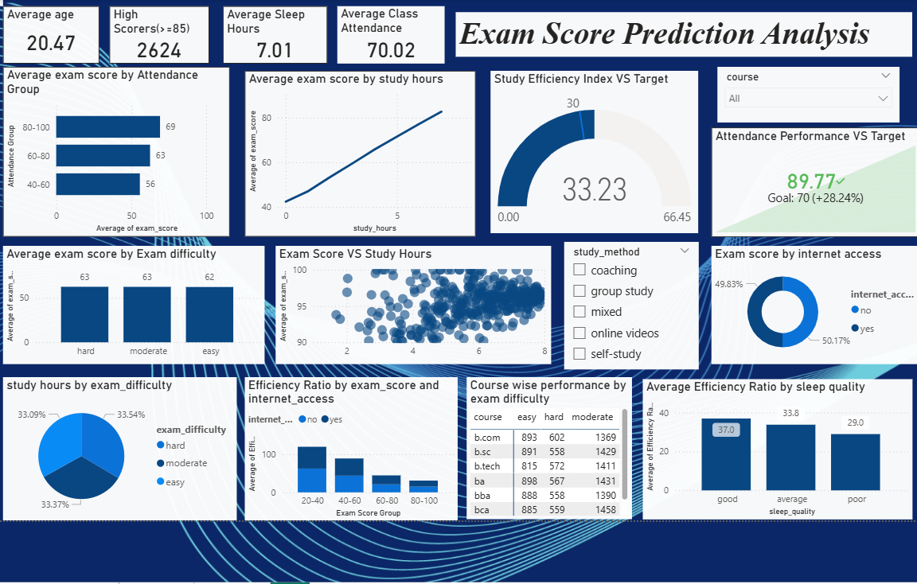
DASHBOARD OVERVIEW
This dashboard shows how students’ exam scores vary based on key factors such as study hours, attendance, sleep quality, and study methods.
It helps in identifying patterns in performance and comparing different groups using interactive filters.

Slide 4
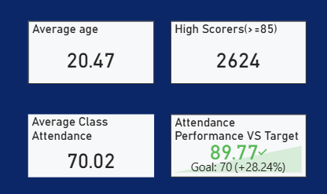
STUDENT PERFORMANCE SNAPSHOT
Shows the overall performance of students at a glance.
Attendance performance is compared against a target to track consistency.
High scorers indicate the number of top-performing students.
Average sleep hours and class attendance provide context about student lifestyle.
This helps in understanding the general performance before going into deeper analysis.

Slide 5
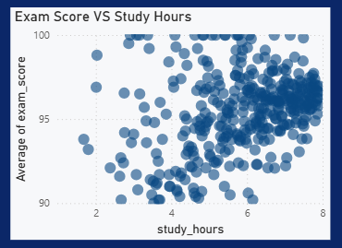
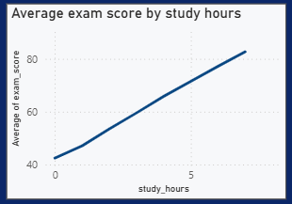
EXAM SCORE VS STUDY HOURS
SCATTER PLOT
LINE CHART
Each point represents one student
Shows how exam scores change with study hours
Students who study more hours generally score higher
Shows the average exam score for different study hour levels
Represents the overall trend between study hours and performance
The upward trend indicates that higher study hours lead to higher average scores

Slide 6
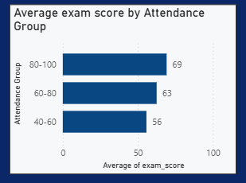
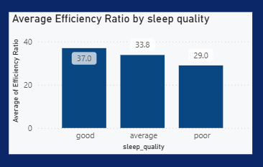
Impact of Attendance and Sleep Quality on Performance
Students with higher attendance generally perform better in exams
Regular attendance helps in better understanding of course concepts
Sleep quality has a clear impact on student efficiency and performance
Students with good sleep quality show better average performance
Both attendance and sleep are important lifestyle factors that influence results

Slide 7
KEY INSIGHTS
Students who study more hours generally score higher in exams
Attendance has a strong impact on student performance
Better sleep quality is linked with higher study efficiency and exam scores
High scorers are more common among students with consistent study habits
Interactive filters help compare performance across different courses and study methods

Slide 8
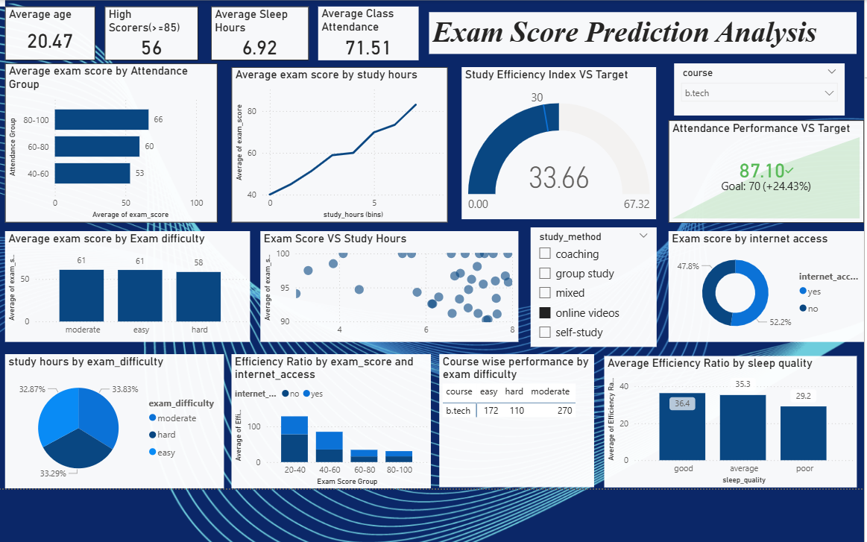
Filtered Analysis : B . Tech Students (Online Videos)
In this filtered group, students studying around 5–7 hours tend to have noticeably higher average exam scores.
Students with 80–100% attendance perform better than those in lower attendance groups, even when study method is online videos.
B . Tech students with good sleep quality show higher efficiency compared to those with average or poor sleep.
The performance trend suggests that online video learners perform better when they are consistent in study hours and attendance, not just by watching videos alone.

Slide 9
THANK YOU

